Slide 1

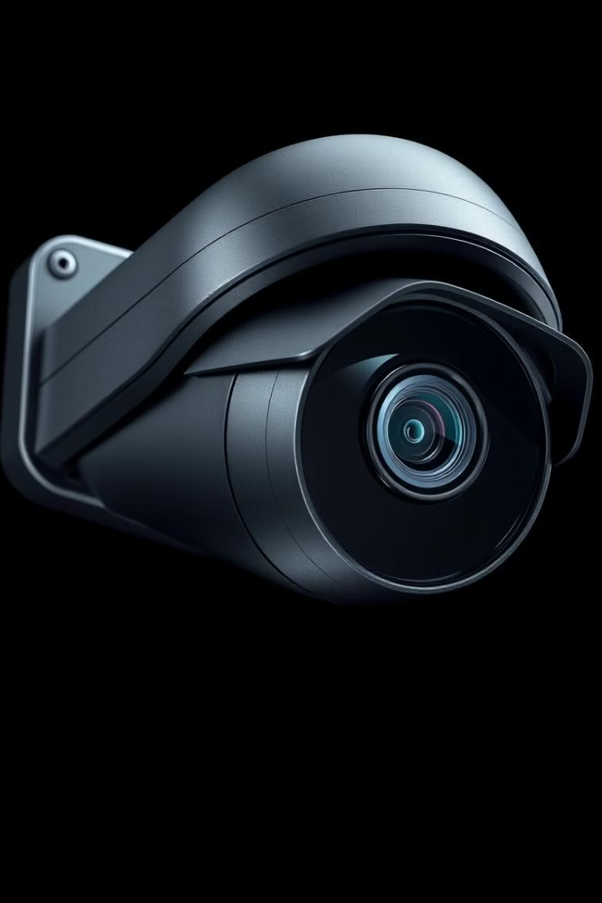

ANTI-THEFT SURVEILLANCE CAMERA
Guarding Your World: Our Cameras, Your Security.

Slide 2


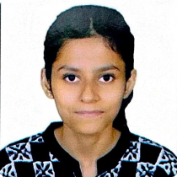

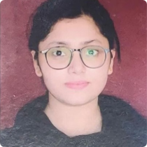
OUR TEAM
Meet the dedicated individuals behind our anti-theft surveillance camera project
NITISH
AMANPREET
SOUMYA
KUMAR
KAUR
UPADHYAY
ID:211001001079
ID: 211001001032
ID:21100100106
SOUKARJO
ANUSRI
KR. DAS
CHOWDHURY
ID: 211001001004
ID: 211001001017

Slide 3

SEMESTER WORK RECAP
August
Reviewing previous work, researching existing anti-theft surveillance technologies, and brainstorming potential project directions.
October
Beginning work on the physical model, setting up the basic camera and alarm system, and testing initial prototypes.
1
2
3
4
September
November
Working on refining the initial idea, developing a comprehensive project presentation, and outlining key features and functionalities.
Continuing work on the physical model and setup, integrating advanced sensor technologies, and conducting thorough system testing and calibration.

Slide 4
PROJECT MILESTONES
Semester 1
1
Team formed. Initial project planning began.
2
Semester 2
Idea refinement and presentation developed.
Semester 3
3
Initial physical model construction commenced.
4
Semester 4
Continued work on physical model development.
Semester 5
5
Advanced physical model improvements implemented.
6
Semester 6
Physical model completion and final testing.

Slide 5

PROBLEM STATEMENT
Rising Vehicle Thefts
Major Factors
Motor vehicle thefts are increasing in India, even during lockdown.
Lack of parking, casual attitude, and second-hand markets contribute.
Affected Parties
Vehicle owners face violence, threats, and invasion of private properties.

Slide 6


MISSION STATEMENT
Minimize theft and enhance security nationwide with our innovative camera: Our primary goal is to significantly reduce vehicle theft incidents across India by providing a state-of-the-art surveillance solution that acts as a powerful deterrent to potential thieves.
Our mission is to provide peace of mind to vehicle owners by offering a cutting-edge anti-theft surveillance system: We strive to reassure vehicle owners that their property is protected, offering them a sense of security through our advanced technology and reliable surveillance capabilities.
We are committed to leveraging advanced technology to deter criminal activity, assist in vehicle recovery, and create safer communities for everyone: We dedicate ourselves to employing the latest technological advancements to actively prevent criminal activities related to vehicle theft, aid in the swift recovery of stolen vehicles, and contribute to building safer and more secure communities for all citizens.

Slide 7
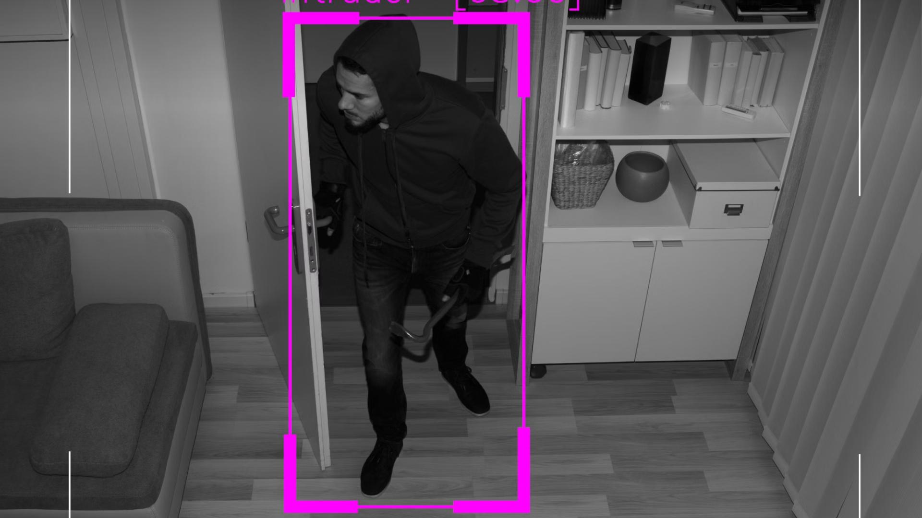



SOLUTION
Intruder Detection
Alert System
Cloud Storage
Our system can trace any intruder attempting to tamper with or steal parts from the vehicle. It captures detailed footage and provides real-time alerts to the owner, enhancing the chances of apprehending the culprit and preventing further damage.
Highly sensitive sensors are strategically placed within and around the vehicle to detect any unauthorized access or suspicious activity. Upon triggering, these sensors promptly send alert signals directly to the owner's smartphone, allowing for immediate awareness and action.
All captured video files and alert logs are securely stored in a dedicated cloud storage system. This ensures that even if the camera itself is damaged or stolen, the crucial evidence remains accessible to the owner and law enforcement, facilitating vehicle recovery and investigation efforts.

Slide 8
SWOT ANALYSIS
Explore our business concept. It provides innovative security features. We offer real-time threat detection and alerts.
Opportunities
Threats
Strengths
Increasing demand for AI-based security systems.
Dependence on internet connectivity for real-time monitoring.
Potential integration with smart home ecosystems.
Rising concerns over data privacy and surveillance ethics.
Expansion into business and corporate security sectors.
Competition from established security brands.
Weaknesses
Government grants and funding opportunities for security innovation.
Risk of cybersecurity attacks targeting the system.
Growing interest in affordable and efficient surveillance for small businesses.
High initial setup costs may limit market adoption.
Potential for false positives leading to unnecessary alerts.

Slide 9

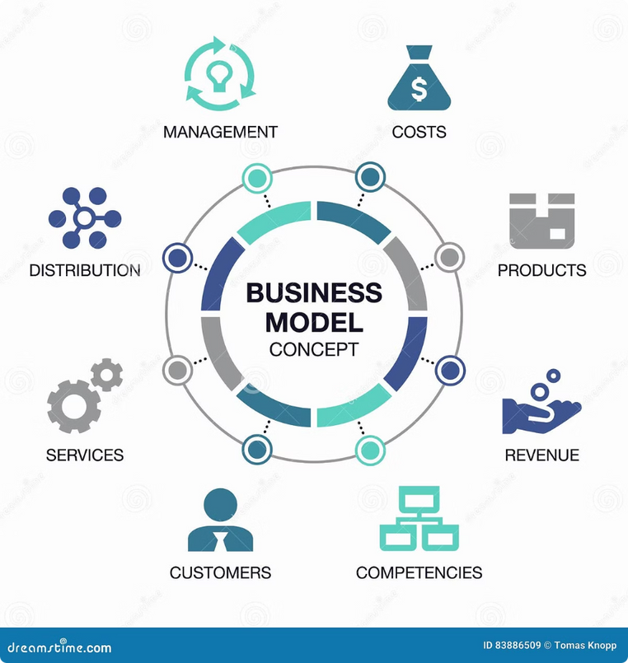
BUSINESS CONCEPT
Our business model centers on leveraging three key areas: e-commerce platforms for direct sales, strategic influencer marketing to build brand awareness, and partnerships with automotive accessories shops for wider distribution.
Our target market includes automobile companies seeking innovative security solutions, businessmen needing reliable vehicle protection, working parents prioritizing family safety, and shopping malls aiming to enhance customer security in parking areas.
Our anti-theft camera will be initially priced at 1499 INR, offering competitive value. We also offer attractive discounts for bulk sales to encourage adoption by larger organizations and dealerships, making our solution accessible and scalable.

Slide 10






STAKEHOLDERS MAP
Partners
Automobile companies seeking innovative security solutions for their vehicles. Advertising companies looking to promote the anti-theft surveillance camera to a broad customer base.
Staff
Product managers responsible for the camera's development and improvement. Marketing managers focused on creating brand awareness and driving sales. Finance managers overseeing the company's budget and financial performance.
Customers
Vehicle owners seeking to protect their cars from theft and vandalism. Parents prioritizing the safety of their families by ensuring their vehicle is secure. Homeowners looking to monitor their driveways and garages for suspicious activity.
Advisors
Dr. Tanmoy Dasgupta, a leading expert in vehicle security and surveillance technology, providing guidance and insights to the company.

Slide 11
TARGET CUSTOMERS / BENEFICIARIES
1
Growing Demand
2
E-Commerce
Consumer electronics demand is rising due to shorter cycles and lower prices.
Easy availability through online platforms boosts frequent purchases.
3
Autonomous Vehicles
4
Targeting Two-Wheelers
Innovations encourage ongoing interest in vehicle tech.
We specialize in security solutions for motorcycles and scooters.

Slide 12
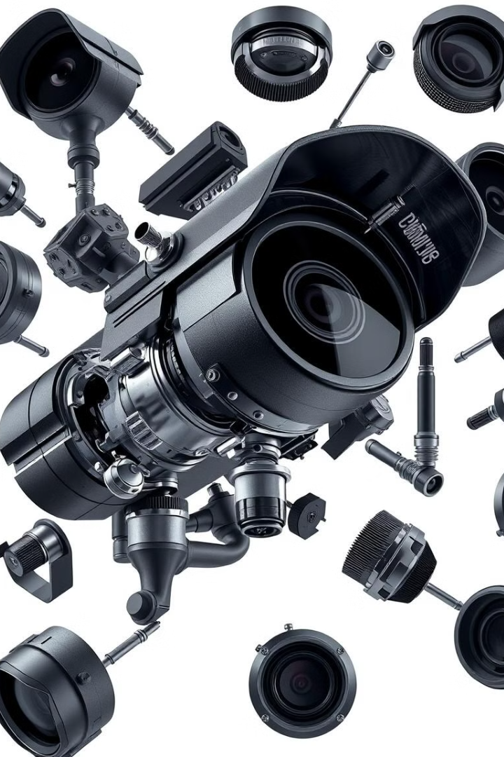
PRICING
Rs 699
ESP32-cam
Rs 149
FTDI module
Rs 54
Jumper wires
Rs 350
Anti-theft lock sensor
Selling price of each unit: RS. 1,818.
This allows for a profit margin that supports ongoing research and development, as well as marketing and distribution efforts. We also offer attractive discounts for bulk sales to encourage adoption by larger organizations and dealerships.

Slide 13
BUSINESS CANVAS MODEL
Component
Details
Key Partners
Hardware suppliers, AI & software developers, cloud service providers, security agencies & law enforcement, government organizations & smart city initiatives.
Key Activities
AI-based threat detection development, system integration with IoT, data processing & cloud storage management, research & development, marketing & customer support.
Key Resources
AI-powered surveillance software, hardware components, cloud storage infrastructure, development team, secure communication & data encryption protocols.
Value Propositions
Real-time, AI-driven theft detection, instant alerts, integration with smart home security, cost-effective solution, easy-to-install interface.
Customer Relationships
24/7 customer support, mobile app for monitoring, subscription-based service, personalized security solutions.
Channels
Direct sales via website & mobile app, partnerships with security firms & retailers, online marketplaces, B2B collaborations.
Customer Segments
Homeowners, small and medium businesses, government agencies, smart city initiatives, large enterprises.
Cost Structure
Hardware manufacturing, AI model development, cloud storage, marketing, R&D.
Revenue Streams
Device sales, subscription services, licensing AI software, B2B contracts.

Slide 14
UNIQUENESS OF THE PROJECT
Existing Solutions
Our Unique Approach
Many projects offer some degree of functionality in this space, but they often fall short in several key areas. For example, some solutions are too complex for the average user, requiring significant technical expertise. Others are limited in scope, only addressing a small subset of the overall problem. Finally, many existing tools lack the scalability needed to handle large datasets or complex workflows.
Our project is unique because it addresses all of these shortcomings. We've designed a user-friendly interface that makes it easy for anyone to get started, regardless of their technical background. Our solution is comprehensive, covering the full range of functionality needed to solve the problem. And, critically, we've built our platform to be highly scalable, ensuring that it can handle even the most demanding workloads.
In addition, we offer personalized support and training to help our users maximize the value of our platform.

Slide 15

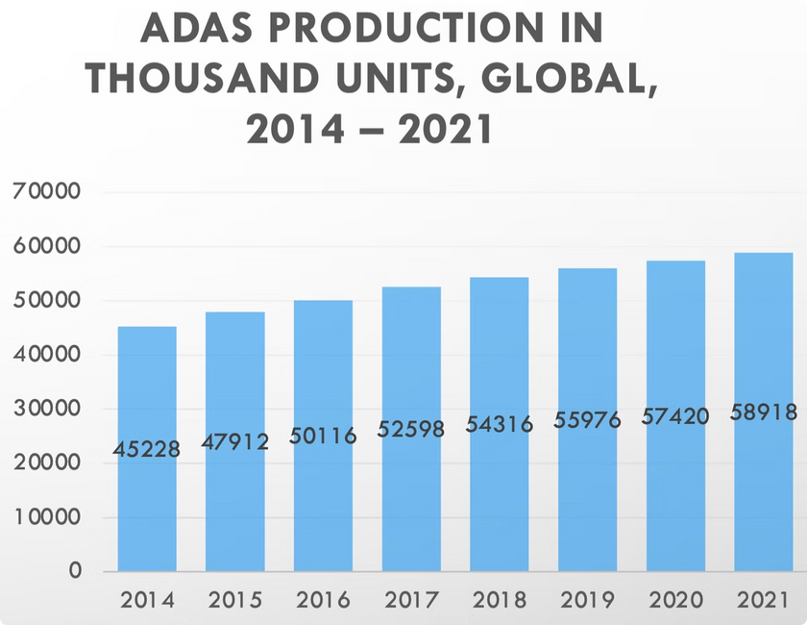
MARKET SUMMARY
Global camera modules market to reach USD 58.5 billion by 2026.
Growth of 6.8% expected by 2025.
Increasing demand for surveillance cameras in commercial and residential sectors.
Rising adoption of ADAS (Advanced Driver Assistance Systems) in automobiles.
Growing popularity of camera-equipped smartphones and other consumer electronics.
Technological advancements in image sensors and processing.

Slide 16
CONCLUSION
Our anti-theft surveillance camera delivers:
Superior Security: Our system provides a dependable anti-theft surveillance, ensuring real-time monitoring and immediate alerts in case of suspicious activity. This helps deter potential thieves and provides valuable evidence for law enforcement.
Customizable Solutions: Our camera is easily adaptable to various vehicle models and specific security needs. Its modular design allows users to select the features that best suit their requirements, ensuring a tailored security solution for every vehicle.
Cost-Efficiency: We offer a budget-conscious security option without compromising on quality or effectiveness. By optimizing our production process and leveraging affordable components, we deliver a high-value solution accessible to a broad customer base.
Scalable Growth: Our product is ready for new markets and emerging technologies. The platform is designed to easily integrate with new sensors, software updates, and advanced features, ensuring it stays ahead of the curve.
Wide Application: This camera is perfect for cars, motorcycles, and scooters. The compact design and versatile mounting options allows for easy installation in a wide range of vehicles, making it an ideal security solution for diverse transportation needs.
Significant Market Potential: Our anti-theft surveillance camera is poised to capture the rising demand for advanced vehicle security. The increasing concerns about vehicle theft, coupled with the growing popularity of in-vehicle technology, position our product for strong market penetration and sustained growth.

Slide 17

THANK YOU
Thank you for considering our anti-theft surveillance camera project.

